Slide 1
Predicting Log Likelihood Ratios With Machine Learning
By: Jonathan Nguyen
Ucla id: 304929013

Slide 2
Generating the Data
Data was generated using MATLAB
Use pre-defined “constellation maps” to map randomly generated source bits to a symbol
Each constellation map was constructed with an average symbol energy of 1
Also note that each constellation map was constructed in ascending bit order
constellation_map(1) corresponds to 0000, constellation_map(2) corresponds to 0001
Add complex AWGN noise to each entry of our symbol vector
Calculate Log-Likelihood Ratio of each bit
Export the Data as a .csv file to be fed into Python

Slide 3
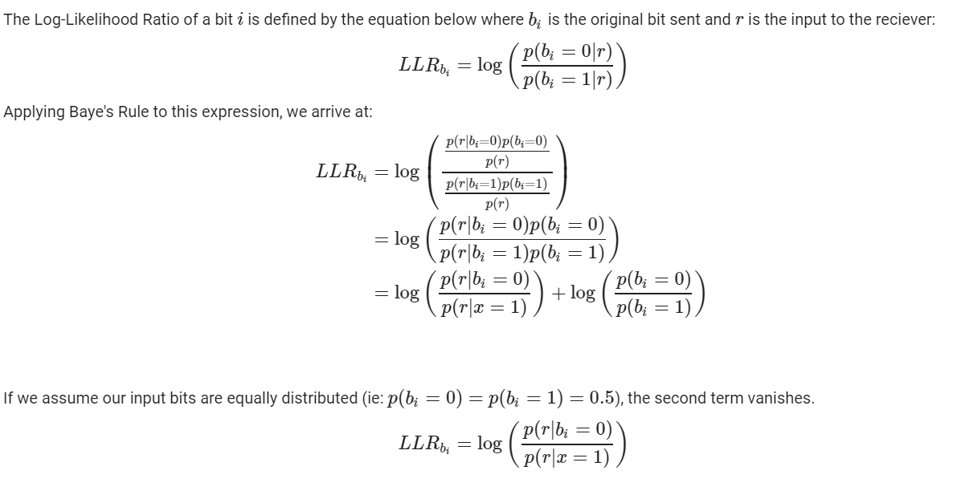
Calculating LLRs

Slide 4
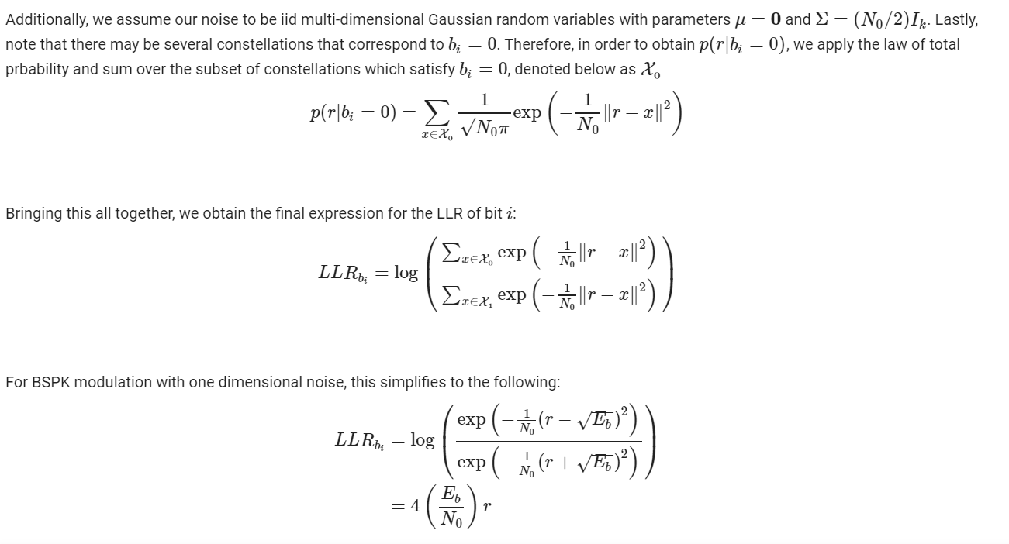
Calculating LLRs (Cont.)

Slide 5
Calculating LLRs: The Algorithm
Store sum of exp() terms corresponding to ith bit = 0 in a variable called num_sum
Do the same for ith bit = 1 with a variable called dem_sum
Loop through constellation map, swap whether looking at 0 or 1 every 2^(i-1) iterations
Apply log ( num_sum / dem_sum) to get LLR
Bit 3 | Bit 2 | Bit 1 | Index in Constellation map
0 | 0 | 0 | 1
0 | 0 | 1 | 2
0 | 1 | 0 | 3
0 | 1 | 1 | 4
1 | 0 | 0 | 5
1 | 0 | 1 | 6
1 | 1 | 0 | 7
1 | 1 | 1 | 8

Slide 6
Additional Features
Can generate symbols / LLRs over a range of SNRs
Can generate symbols / LLRs for a single SNR with fading
Fading attenuation follows Rayleigh distribution and phase shift is uniformly distributed over [0, 2π]
Receiver assumes no fading however

Slide 7
Neural Network Model Overview
Utilized Keras Library to construct a fully connected MIMO network
Each input to the network corresponds to the in-phase and quadrature component of our symbol respectively
Each output corresponds to the predicted LLR of each bit
For BPSK, there is 1 output, QPSK has 2 outputs, …, 16_QAM has 4 outputs
Network contains 6-7 hidden layers which progressively smaller layer sizes
The hidden layers are shared between all outputs
Output of hidden layers are fed into several layers that are each unique to each bit

Slide 8
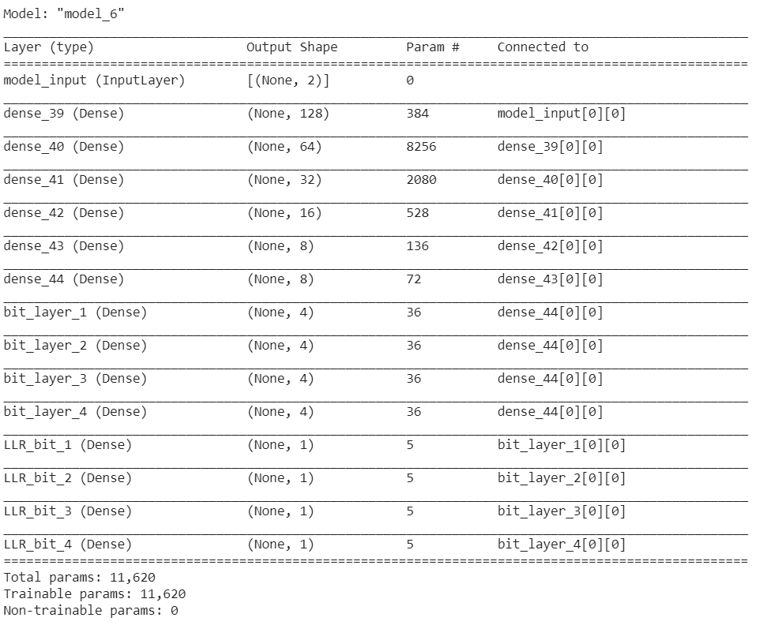
Example Model Summary

Slide 9
Selecting Hyperparameters
The metric was chosen as Mean Squared Error (MSE)
Reason: We are working with soft outputs; Therefore, we want to minimize the distance between the predicted LLR and the actual LLR
Loss function was chosen to be logcosh:
Reason: For small differences, logcosh behaves similarly to mean squared error (x^2 / 2). For larger differences, it behaves closer to abs(x) - log(2) which is more linear. This has the effect of not penalizing wildly incorrect predictions as heavily which may skew the model towards overfitting those points.
ReLU was chosen for the activation function empirically
Reason: Through running several tests, it was shown to result in the lowest MSE and training time compared to sigmoid, tanh, etc. This is backed up by other papers.

Slide 10
Dropout and Batch Normalization
I did not use Batch Normalization in my model because it resulted in worse training and validation accuracy.
Perhaps if I ran my model for more epochs, this issue may have gone away.
The purpose of bathnorm is to ensure that the input to each layer has the same statistics (mean and variance).
This is a form of regularization which can help the model train faster and prevent overfitting.
Dropout did not help when training, so I did not use it in any model except for the fading channel.
In fact, for dropout rates 0.1, 0.2, and 0.5, the performance of the models trained on a single SNR and an SNR range degraded.
Even on the fading channel, the improvement was marginal
Dropout prevents overfitting by only giving the model access to a subset of the data at a time
This can be viewed as an approximate form of bagging

Slide 11
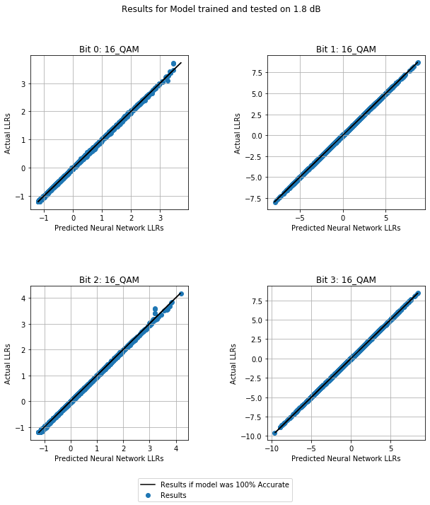
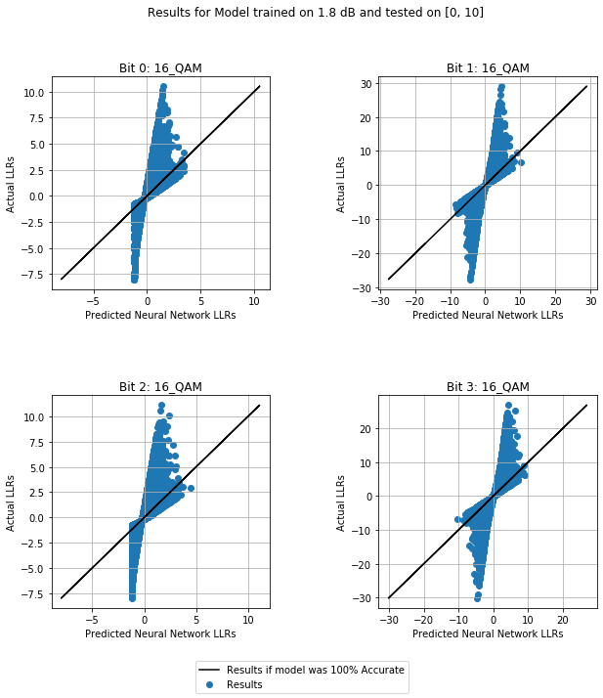
Results (16 QAM trained on 1.8 dB data)

Slide 12
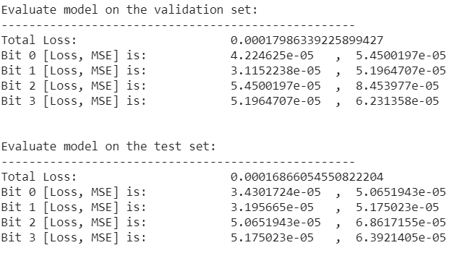
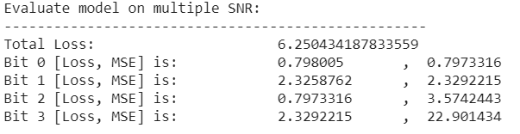
Results (16 QAM trained on 1.8 dB data)
Trained and Tested on 1.8 dB data:
Trained on 1.8 dB data, tested on [0,10] dB:

Slide 13
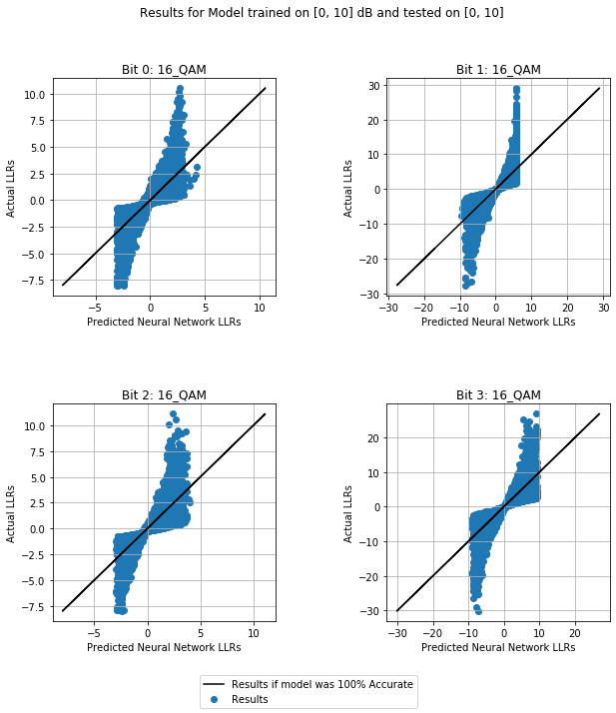
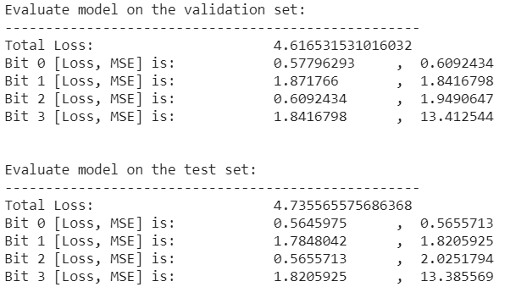
Results (16 QAM trained on [0,10] dB data)

Slide 14
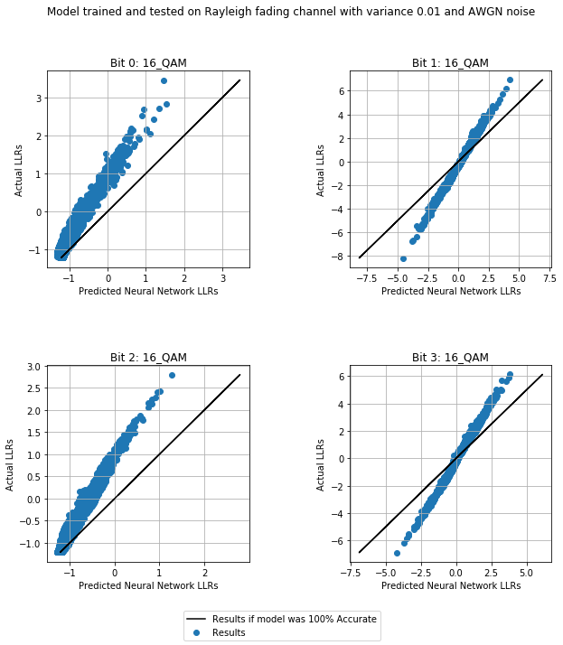
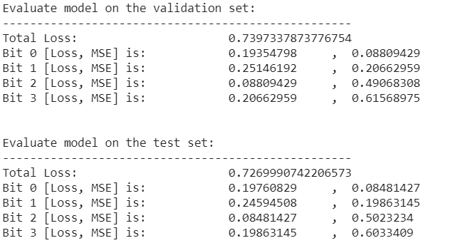
Results (16 QAM trained on 1.8 dB data with fading)

Slide 15
Inferences
Neural Networks perform excellent when testing at the same SNR they were trained at
Poor generalization to other SNRs
Training on a range of SNRs can result in mixed results depending on how large the range is

Slide 16
Implementation with Channel Coding
I had previously written code to simulate Frame Error Rates (FER) when decoding LDPC codes given their parity check matrix.
Simulation assumes all zeros codeword was sent
However the code was written in C++ as opposed to Python or MATLAB
Used library to import pre-trained model from Python into C++
Frugally Deep Library
Decoder was implemented using double-precision belief propagation (message passing) and with a relatively short block length code
802.11n LDPC Code with rate= 0.5 and n=1296
Currently assuming no puncturing, but the software simulation supports it
Belief Propagation meaning that check node and variable node messages use the boxplus formula with tanh and log
Future work could include min sum / min* approximation with NN generated LLRs

Slide 17
Channel Coding Simulations
Export the trained Neural Network as a .h5 file
I chose the BPSK model trained at SNR 1.8 dB for this round
Can also import other modulation models but their modulation order needs to be a factor of 1296
Convert the .h5 file to a .json
Load the model into C++ using Frugally-Deep, Json, Functional-Plus, and Eigen libraries
Assuming all-zero codeword transmission, generate LLRs and feed into decoder
Run at each SNR until 100 frame errors reached (more would give smoother curve but takes longer)

Slide 18
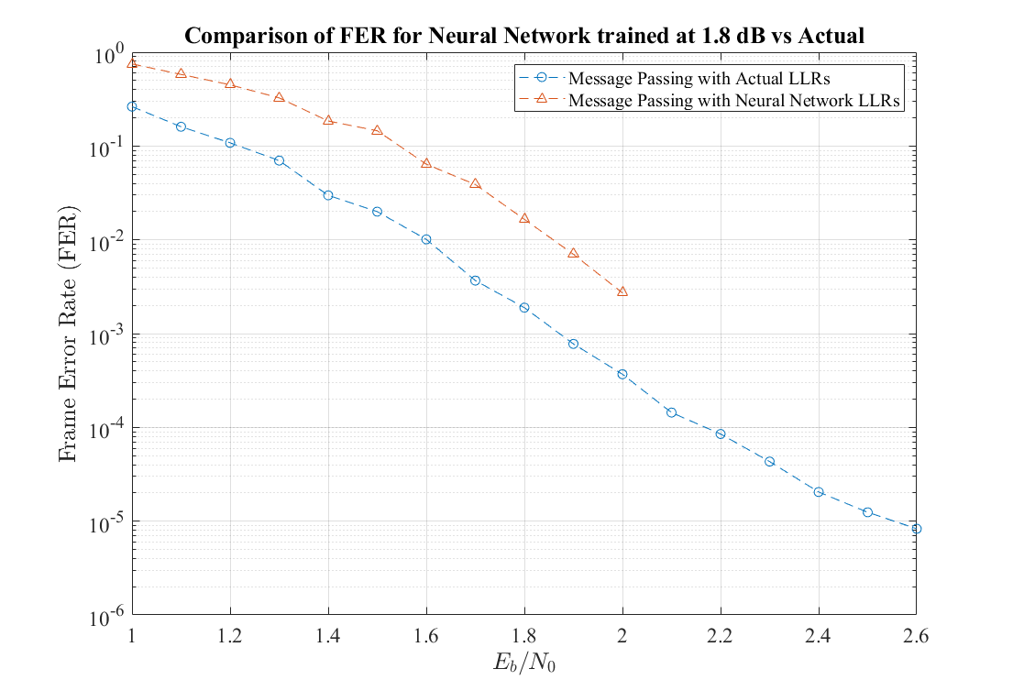
Results

Slide 19
Neural Network Results for Other Modulation Schemes

Slide 20
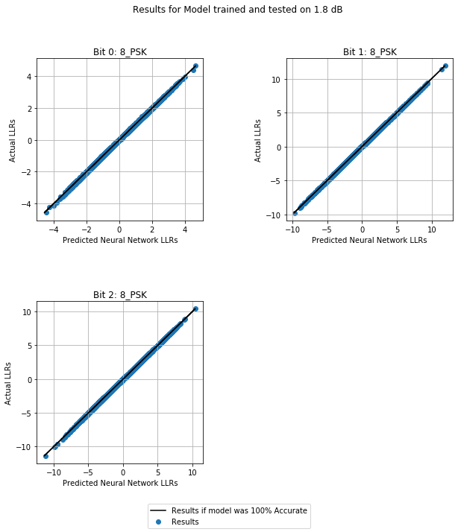
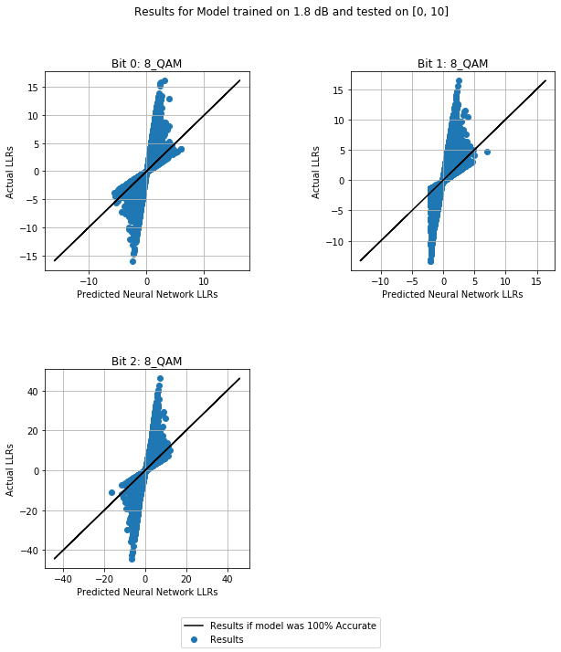
Results (8 QAM trained on 1.8 dB data)

Slide 21
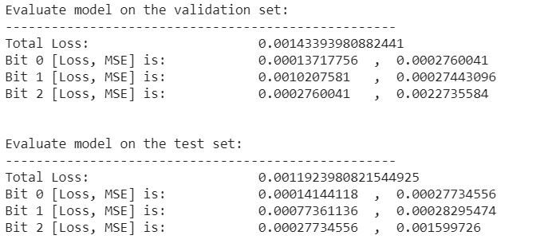
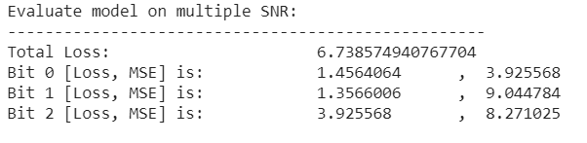
Results (8 QAM trained on 1.8 dB data)
Trained and Tested on 1.8 dB data:
Trained on 1.8 dB data, tested on [0,10] dB:

Slide 22
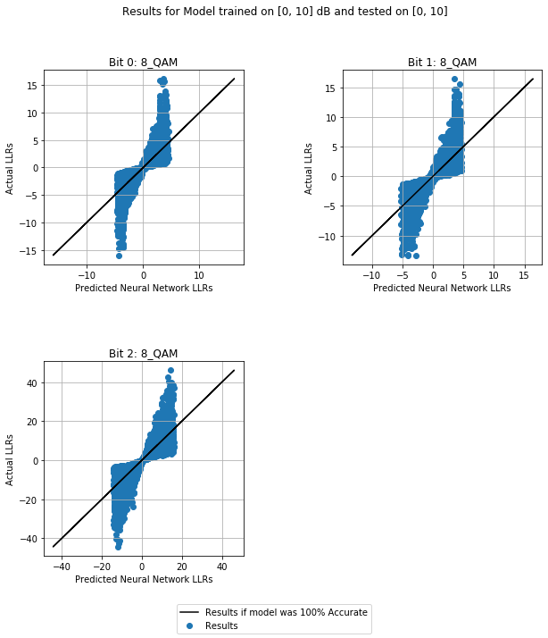
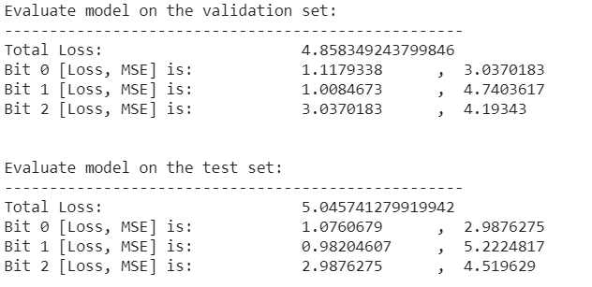
Results (8 QAM trained on [0,10] dB data)

Slide 23
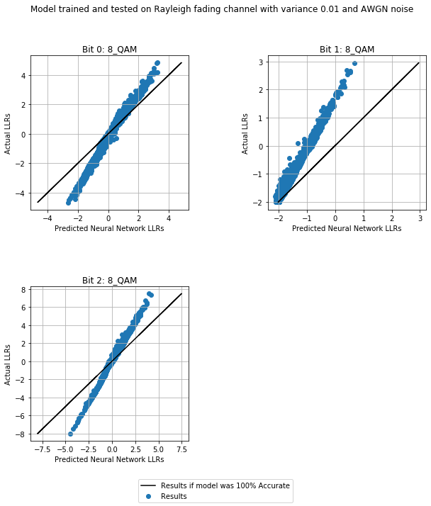
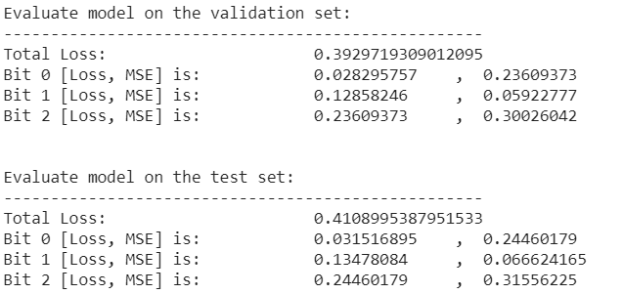
Results (8 QAM trained on 1.8 dB data with fading)

Slide 24
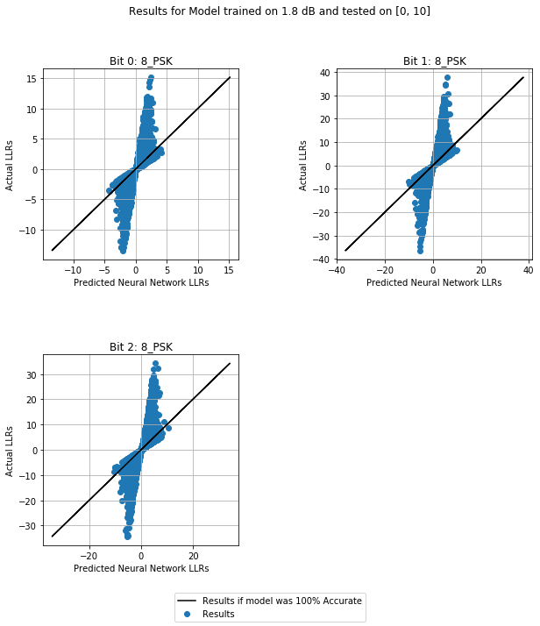
Results (8PSK trained on 1.8 dB data)

Slide 25
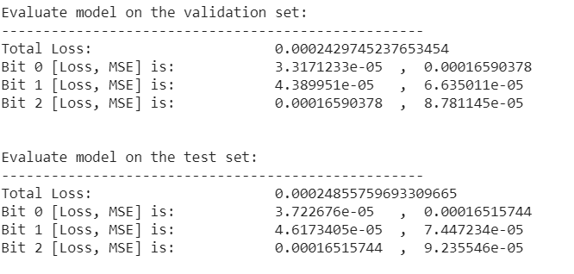
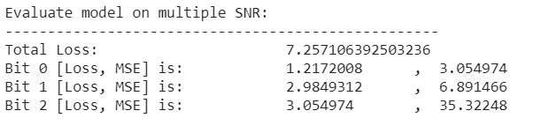
Results (8PSK trained on 1.8 dB data)
Trained and Tested on 1.8 dB data:
Trained on 1.8 dB data, tested on [0,10] dB:

Slide 26
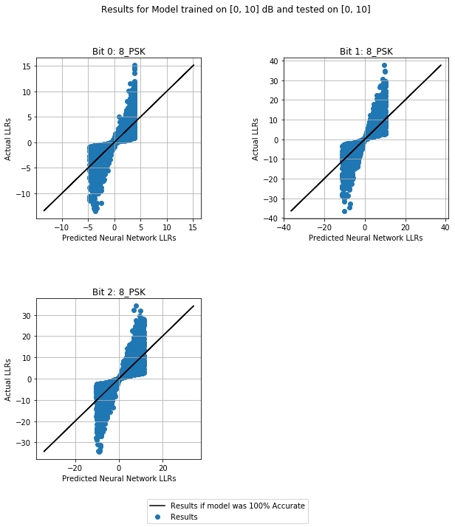
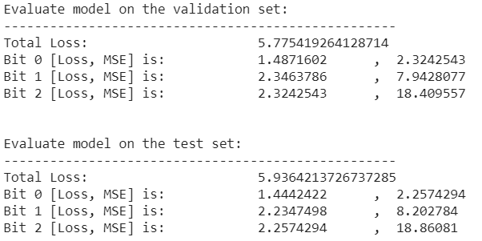
Results (8PSK trained on [0,10] dB data)

Slide 27
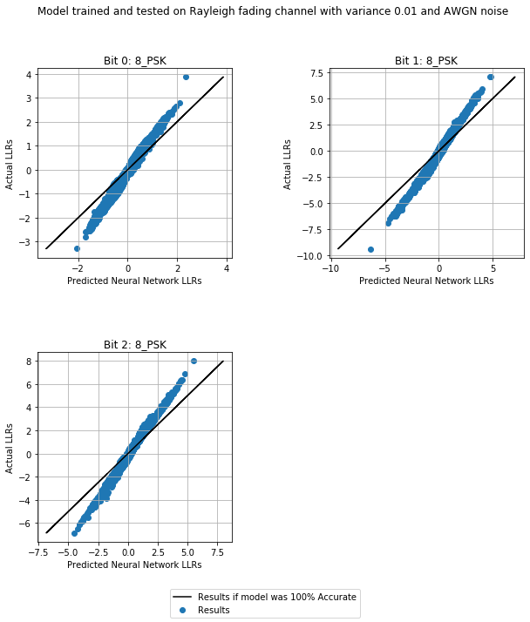
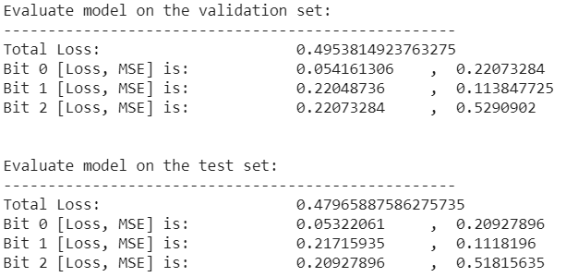
Results (8PSK trained on 1.8 dB data with fading)

Slide 28
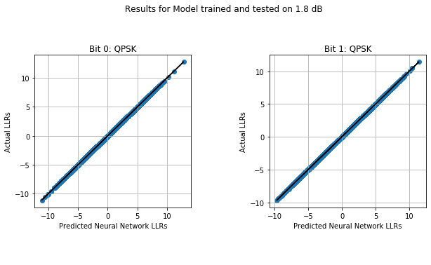
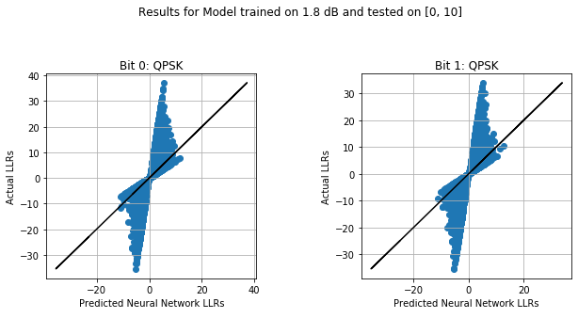
Results (QPSK trained on 1.8 dB data)

Slide 29
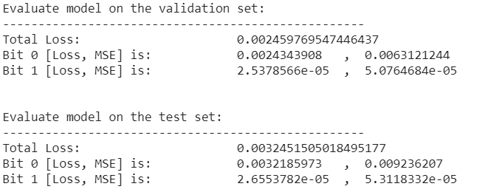
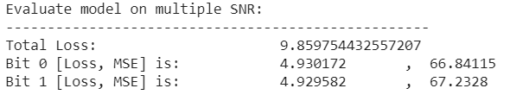
Results (QPSK trained on 1.8 dB data)
Trained and Tested on 1.8 dB data:
Trained on 1.8 dB data, tested on [0,10] dB:

Slide 30
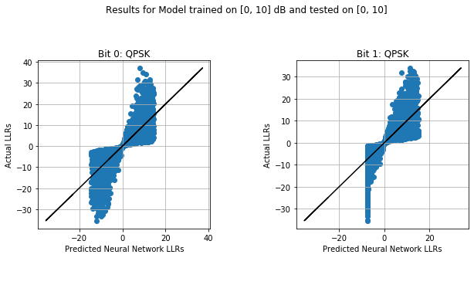
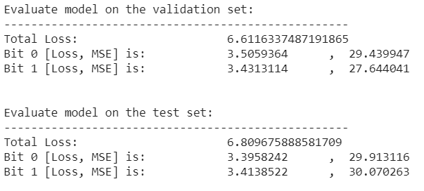
Results (QPSK trained on [0,10] dB data)

Slide 31
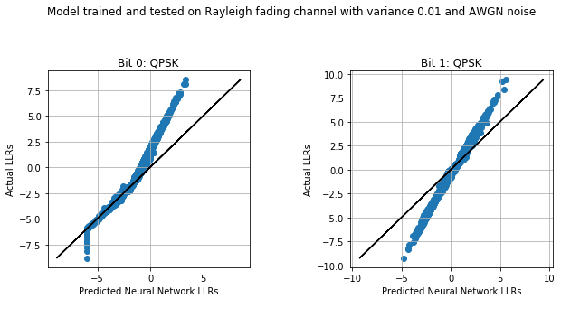
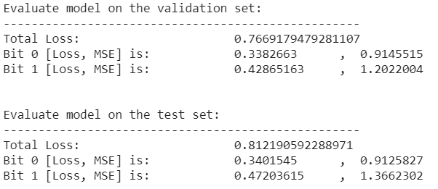
Results (QPSK trained on 1.8 dB data with fading)

Slide 32
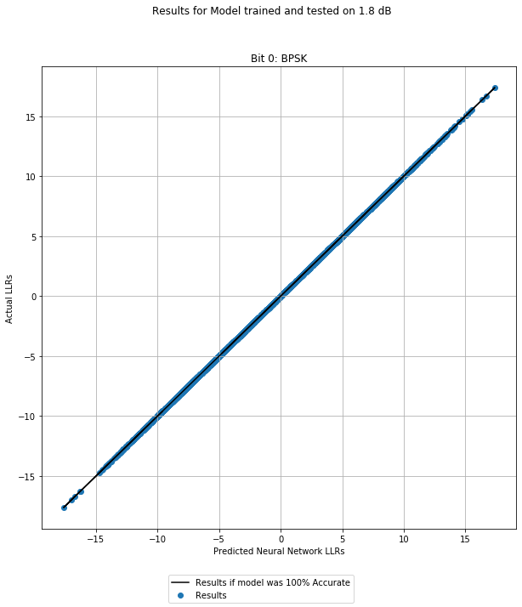
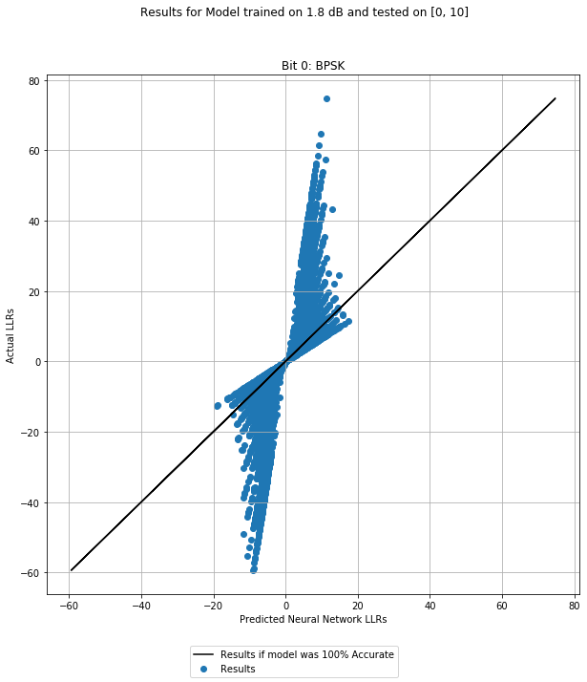
Results (BPSK trained on 1.8 dB data)

Slide 33
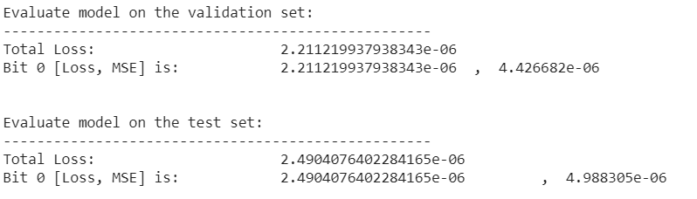
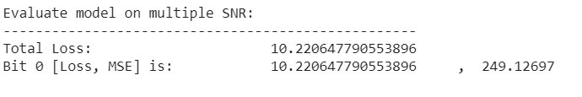
Results (BPSK trained on 1.8 dB data)
Trained and Tested on 1.8 dB data:
Trained on 1.8 dB data, tested on [0,10] dB:

Slide 34
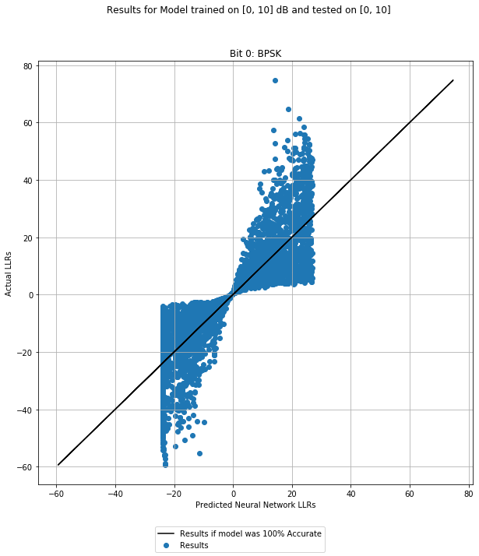
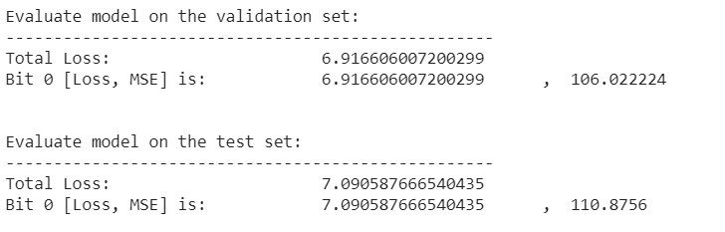
Results (BPSK trained on [0,10] dB data)

Slide 35
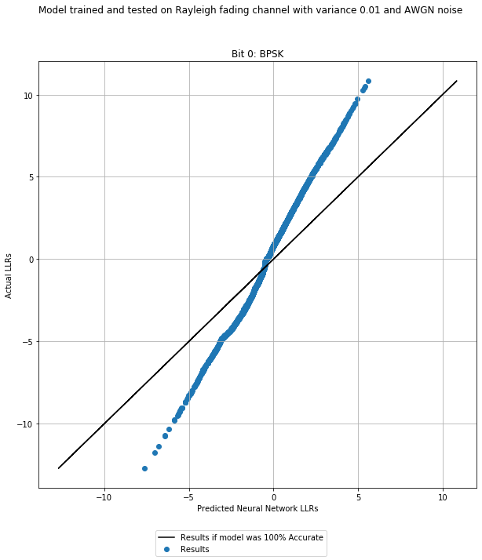
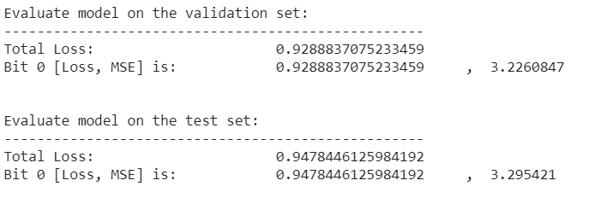
Results (BPSK trained on 1.8 dB data with fading)

